Slide 1
Chapter 8: Computer Reliability

Slide 2
Chapter Overview
Introduction
Data-entry or data-retrieval errors
Software and billing errors
Notable software system failures
Therac-25
Computer simulations
Software engineering
Software warranties

Slide 3
8.1 Introduction
Computer systems are sometimes unreliable
Erroneous information in databases
Misinterpretation of database information
Malfunction of embedded systems
Effects of computer errors
Inconvenience
Bad business decisions
Fatalities

Slide 4
8.2 Data-Entry or Data-Retrieval Errors

Slide 5
Two Kinds of Data-related Failure
A computerized system may fail because wrong data entered into it
A computerized system may fail because people incorrectly interpret data they retrieve

Slide 6
Disfranchised Voters
November 2000 general election
Florida disqualified thousands of voters
Reason: People identified as felons
Cause: Incorrect records in voter database
Consequence: May have affected election’s outcome

Slide 7
False Arrests
Three cases of false arrests due to incorrect information retrieved from the NCIC
Sheila Jackson Stossier mistaken for Shirley Jackson
Arrested and spent five days in detention
Roberto Hernandez mistaken for another Roberto Hernandez
Arrested twice and spent 12 days in jail
Terry Dean Rogan arrested after someone stole his identity
Arrested five times, three times at gun point

Slide 8
Accuracy of NCIC Records
March 2003: Justice Dept. announces FBI not responsible for accuracy of NCIC information
Exempts NCIC from some provisions of Privacy Act of 1974
Should government take responsibility for data correctness?

Slide 9
Dept. of Justice Position
Impractical for FBI to be responsible for data’s accuracy
Much information provided by other law enforcement and intelligence agencies
Agents should be able to use discretion
If provisions of Privacy Act strictly followed, much less information would be in NCIC
Result: fewer arrests

Slide 10
Position of Privacy Advocates
Number of records is increasing
More erroneous records → more false arrests
Accuracy of NCIC records more important than ever

Slide 11
Analysis: Database of Stolen Vehicles
> 1 million cars stolen every year
Owners suffer emotional, financial harm
Raises insurance rates for all
Transporting stolen car across a state line
Before NCIC, greatly reduced chance of recovery
After NCIC, nationwide stolen car retrieval
At least 50,000 recoveries annually due to NCIC
Few stories of faulty information causing false arrests
Benefit > harm → Creating database the right action

Slide 12
8.3 Software and Billing Errors

Slide 13
Errors When Data Are Correct
Assume data correctly fed into computerized system
System may still fail if there is an error in its programming

Slide 14
Errors Leading to System Malfunctions (PP. 358-359)
Qwest sent incorrect bills to cell phone customers
Faulty USDA beef price reports
U.S. Postal Service returned mail addressed to Patent and Trademark Office
Spelling and grammar error checkers increased errors
New York City Housing authority overcharged renters
About 450 California prison inmates mistakenly released

Slide 15
Errors Leading to System Failures (PP.359-360)
Ambulance dispatch system in London (1992)
Chicago Board of Trade (1998)
BMW limousine (2003)
Japan’s air traffic control system (2003)
Los Angeles County + USC Medical Center laboratory computer system (2003)
Comair Cancelled All Flights on Christmas Day (2004)
Boeing 777 (2005)

Slide 16
Analysis: E-Retailer Posts Wrong Price, Refuses to Deliver
Amazon.com in Britain offered iPaq for £7 instead of £275
Orders flooded in
Amazon.com shut down site, refused to deliver unless customers paid true price
Was Amazon.com wrong to refuse to fill the orders?

Slide 17
Rule Utilitarian Analysis
Imagine rule: A company must always honor the advertised price
Consequences
More time spent proofreading advertisements
Companies would take out insurance policies
Higher costs → higher prices
All consumers would pay higher prices
Few customers would benefit from errors
Conclusion
Rule has more harms than benefits
Amazon.com did the right thing

Slide 18
Kantian Analysis
Buyers knew 97.5% markdown was an error
They attempted to take advantage of Amazon.com’s stockholders
They were not acting in “good faith”
Buyers did something wrong

Slide 19
8.4 Notable Software System Failures
An embedded system is a computer used as a component of a larger system
Every embedded system has a software component
Hardware controllers are being replaced by software controllers
Real-time system: computer that process data from sensors as events occur, e.g. microprocessor controlling air bags in a modern automobile
7 examples of computer system failures
Part of each failure was due to errors in software components of the system

Slide 20
Patriot Missile (1991)
Designed as anti-aircraft missile
Used in 1991 Gulf War to intercept Scud missiles
One battery failed to shoot at Scud that killed 28 soldiers
Designed to operate only a few hours at a time
Kept in operation > 100 hours
Tiny truncation errors added up
Clock error of 0.3433 seconds → tracking error of 687 meters

Slide 21
Patriot Missile Failure
Figure from SCIENCE 255:1347. Copyright ©1992 by The American Association for the Advancement of Science. Reprinted with permission.

Slide 22
Ariane 5 (1996)
Satellite launch vehicle
40 seconds into maiden flight, rocket self-destructed
$500 million of uninsured satellites lost
Statement assigning 64-bit floating-point value to 16-bit signed integer raised exception
Exception not caught and computer crashed
Code reused from Ariane 4
Slower rocket
Smaller values being manipulated
Exception was impossible

Slide 23
AT&T Long-Distance Network (1990)
Significant service disruption
About half of telephone-routing switches crashed
70 million calls not put through
60,000 people lost all service
AT&T lost revenue and credibility
Cause
Single line of code in error-recovery procedure
Most switches running same software
Crashes propagated through switching network

Slide 24
AT&T Long Distance Network Failure

Slide 25
Robot Missions to Mars (1999)
Mars Climate Orbiter
Disintegrated in Martian atmosphere
Lockheed Martin design used English units
Jet Propulsion Lab design used metric units
Mars Polar Lander
Crashed into Martian surface
Engines shut off too soon
False signal from landing gear

Slide 26
Denver International Airport (1993-5)
BAE built automated baggage handling system
Problems
Airport designed before automated system chosen
Timeline too short
System complexity exceeded development team’s ability
Results
Added conventional baggage system
16-month delay in opening airport
Cost Denver $1 million a day

Slide 27
Tokyo Stock Exchange (2005)
First day of trading for J-Com
Mizuho Securities employee mistakenly entered order to sell 610,00 shares at 1 yen, instead of 1 share at 610,000 yen
Employee overrides computer warning
After sell order posted on exchange’s display board, Mizuho tried to cancel order several times; software bug caused attempts to fail
Mizuho lost $225 million buying back shares

Slide 28
Direct Recording Electronic Voting Machines (2006)
After problems with 2000 election, Congress passed Help America Vote Act of 2002
HAVA provided money to states to replace punch card voting systems
Many states used HAVA funds to purchase direct recording electronic (DRE) voting machines
Brazil and India have run national elections using DRE voting machines exclusively
In November 2006 1/3 of U.S. voters used DRE voting machines

Slide 29
Diebold Electronic Voting Machine
© AP Photo/Rogelio Solis

Slide 30
Issues with DRE Voting Machines
Voting irregularities
Failure to record votes
Overcounting votes
Misrecording votes
Lack of a paper audit trail
Vulnerability to tampering
Source code a trade secret, can’t be examined
Possibility of widespread fraud through malicious programming

Slide 31
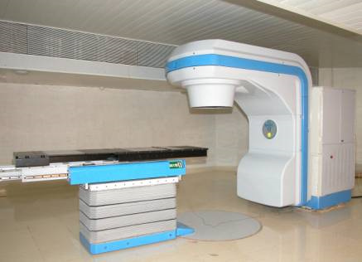
8.5 Therac-25 (PP.371-378)

Slide 32
Genesis of the Therac-25
AECL and CGR built Therac-6 and Therac-20
Therac-25 built by AECL
PDP-11 an integral part of system
Hardware safety features replaced with software
Reused code from Therac-6 and Therac-20
First Therac-25 shipped in 1983
Patient in one room
Technician in adjoining room

Slide 33
Chronology of Accidents and AECL Responses
Marietta, Georgia (June 1985)
Hamilton, Ontario (July 1985)
First AECL investigation (July-Sept. 1985)
Yakima, Washington (December 1985)
Tyler, Texas (March 1986)
Second AECL investigation (March 1986)
Tyler, Texas (April 1986)
Yakima, Washington (January 1987)
FDA declares Therac-25 defective (February 1987)

Slide 34
Software Errors
Race condition: order in which two or more concurrent tasks access a shared variable can affect program’s behavior
Two race conditions in Therac-25 software
Command screen editing
Movement of electron beam gun

Slide 35
Race Condition Revealed by Fast-typing Operators

Slide 36
Race Condition Caused by Counter Rolling Over to Zero

Slide 37
Post Mortem
AECL focused on fixing individual bugs
System not designed to be fail-safe
No devices to report overdoses
Software lessons
Difficult to debug programs with concurrent tasks
Design must be as simple as possible
Documentation crucial
Code reuse does not always lead to higher quality
AECL did not communicate fully with customers

Slide 38
Moral Responsibility of the Therac-25 Team
Conditions for moral responsibility
Causal condition: actions (or inactions) caused the harm
Mental condition
Actions (or inactions) intended or willed -OR-
Moral agent is careless, reckless, or negligent
Therac-25 team morally responsible
They constructed the device that caused the harm
They were negligent

Slide 39
Postcript
Computer errors related to radiation machines continue to maim and kill patients
Investigation by The New York Times
Scott Jerome-Parks, New York (2006)
Alexandra Jn-Charles, New York (2006)

Slide 40
8.6 Computer Simulations

Slide 41
Uses of Simulations
Simulations replace physical experiments
Experiment too expensive or time-consuming
Experiment unethical
Experiment impossible
Model past events
Understand world around us
Predict the future

Slide 42
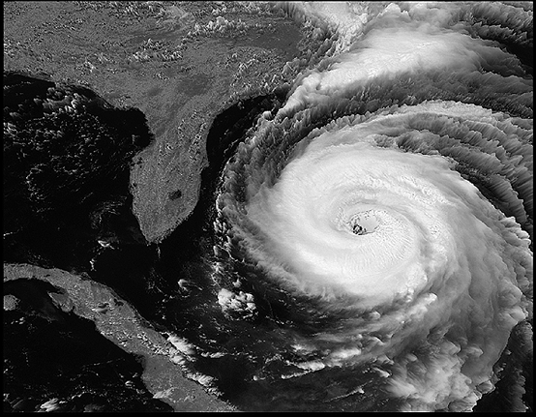
Simulations Predict Path and Speed of Hurricanes
Courtesy of NASA

Slide 43
Validating Simulations
Verification: Does program correctly implement model?
Validation: Does the model accurately represent the real system?
Validation methods
Make prediction, wait to see if it comes true
Predict the present from old data
Test credibility with experts and decision makers

Slide 44
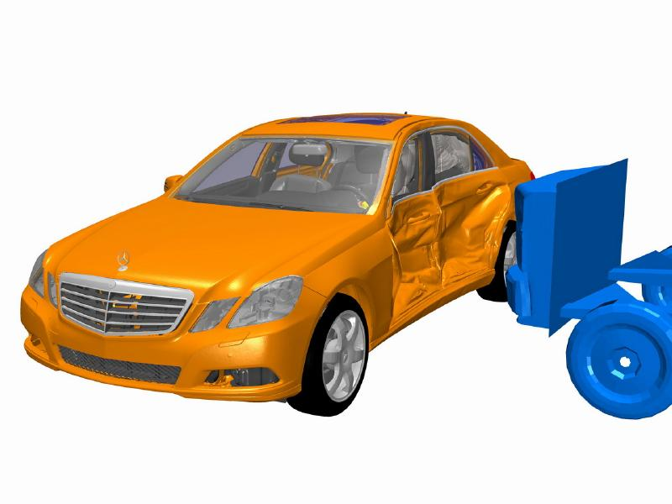
Validation by Comparing Predicted and Actual Outcomes

Slide 45
Validation by “Predicting the Present”

Slide 46
8.7 Software Engineering

Slide 47
Four-step Process to Develop a Software Product
Specification
defining the functions to be performed by the software
Development
producing the software that meets the specification
Validation
testing the software
Evolution
modifying the software to meet the changing needs of the customer

Slide 48
Specification
Determine system requirements
Understand constraints
Determine feasibility
End products
High-level statement of requirements
Mock-up of user interface
Low-level requirements statement

Slide 49
Development
Create high-level design
Discover and resolve mistakes, omissions in specification
CASE tools to support design process
Object-oriented systems have advantages
After detailed design, actual programs written
Result: working software system

Slide 50
Validation (Testing)
Ensure software satisfies specification
Ensure software meets user’s needs
Challenges to testing software
Noncontinuous responses to changes in input
Exhaustive testing impossible
Testing reveals bugs, but cannot prove none exist
Test modules, then subsystems, then system

Slide 51
Software Quality Is Improving
Standish Group tracks IT projects
Situation in 1994
1/3 projects cancelled before completion
1/2 projects had time and/or cost overruns
1/6 projects completed on time / on budget
Situation in 2009
1/6 projects cancelled
1/2 projects had time and/or cost overruns
1/3 projects completed on time / on budget

Slide 52
Success of IT Projects Over Time
1994
2009
On time / On budget
On time / On budget
Canceled
Canceled
Time / Cost overruns
Time / Cost overruns

Slide 53
8.8 Software Warranties

Slide 54
Shrinkwrap Warranties
Some say you accept software “as is”
Some offer 90-day replacement or money-back guarantee
None accept liability for harm caused by use of software

Slide 55
Are Software Warranties Enforceable? (PP. 387-389)
Article 2 of Uniform Commercial Code
Magnuson-Moss Warranty Act (1975)
Step-Saver Data Systems v. Wyse Technology and The Software Link
ProCD, Inc. v. Zeidenberg
Mortenson v. Timberline Software

Slide 56
Moral Responsibility of Software Manufacturers
If vendors were responsible for harmful consequences of defects
Companies would test software more
They would purchase liability insurance
Software would cost more
Start-ups would be affected more than big companies
Less innovation in software industry
Software would be more reliable
Making vendors responsible for harmful consequences of defects may be wrong, but…
Consumers should not have to pay for bug fixes

